Slide 1
Hello
From digitization to eLearning Kevork Krozian

Slide 2
What is eLearning ?
eLearning is learning - not the device or technology (T/F)
The use of technology does not guarantee learning (T/F)
eLearning is when students are engaged with technology (T/F)
eLearning is when students create with technology (T/F)
eLearning is when students learn with technology meeting the relevant VELS or AusVELS standards (T/F)
eLearning is when students are confident with technology (T/F)
Discussion

Slide 3
Session Objectives
Digitization – examples
eLearning overview
Research
eLearning UNESCO/TPACK/SAMR/epotential
eLearning in practice
eLearning and thinking skills
eLearning lower and higher order thinking skills
eLearning – what did we learn? at what standard ?
eLearning – where is the validation and evidence ?
eLearning – how do we sustain embedded eLearning ?

Slide 4
Digitization
eLearning
Students learn by watching teacher explain the work on a white board, then complete a digital copy of a textbook exercise, answer questions, upload answers.
Students complete a static single question type (multiple choice) test online, upload and get a score when the teacher has marked it.
Students receive a score as the only feedback after an online single question style test has been marked by the teacher
Students can only work sequentially through each worksheet in a series.
Students learn initially via teacher guided, then independently with simulation software, answer questions using adaptive software/LMS
Students complete an adaptive test online that is randomized in order overall and within each question for each student, and allows additional attempts at incorrect answers with a penalty loading
Students can get feedback about the area of learning in which they need to improve upon submitting the online test
Students complete formative assessment online with multiple question types ( fill in the gap, multiple choice, True/False etc ) with feedback to inform learning and revision
Students work in a non linear way accessing the work they are capable of doing at any point

Slide 5
eLearning ? Engagement or Edutainment ?
Students create an animation by stepping through a set of onscreen pages ( wizards )
Students assemble a range of content in “comic life” titled eportfolio
Students create a game by drag and drop a set of icons onto the game area
Students play games while the teacher is instructing or when they need to work
Students are not outwardly disruptive but passively off task when required to work on elearning activities
Students are on ebay when required to be on eLearning tasks

Slide 6
eLearning Overview
$50 billion industry worldwide per year
By 2014, 81% of American students will take some or all courses online
Can be synchronous or asynchronous eg. Asynchronous activities use technologies such as blogs, wikis, and discussion boards
Can be through the use of a content management system (CMS) or a Learning management system (LMS)
Can use computer aided assessment for both formative and summative assessment
E-Learning 2.0 assumes that knowledge (as meaning and understanding) is socially constructed
Content is a core component of E-learning and includes issues such as pedagogy and learning object re-use
A common standard format for e-learning content is SCORM whilst other specifications allow for the transporting of "learning objects“

Slide 7
eLearning Overview (contd)
Pedagogical elements are an attempt to define structures or units of educational material
When beginning to create eLearning content, the pedagogical approaches need to be evaluated
Various pedagogical approaches to eLearning include
Constructionism which asserts that learning is particularly effective when constructing something for others to experience
Constructivist which asserts that people actively construct new knowledge as they interact with their environments
Social constructivism extends constructivism into social settings, wherein groups construct knowledge for one another, collaboratively creating a small culture of shared artifacts with shared meanings
Social constructionist extends constructionism into social settings wherein participants construct something for others to experience.

Slide 8
eLearning UNESCO model (2008)
UNESCO ICT Competency Standards for Teachers (ICT-CST)
Collaboration between UNESCO , Cisco, Microsoft and Intel
Proposes a 3 stage approach for educational development
Each of the three stages are in turn addressed by five complementary components of the education system to form the following matrix ..

Slide 9
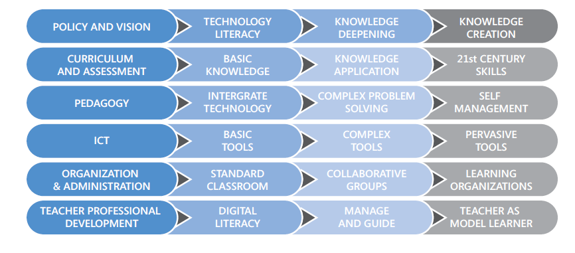
eLearning UNESCO model (2008) - continued
http://unesdoc.unesco.org/images/0015/001562/156207e.pdf

Slide 10
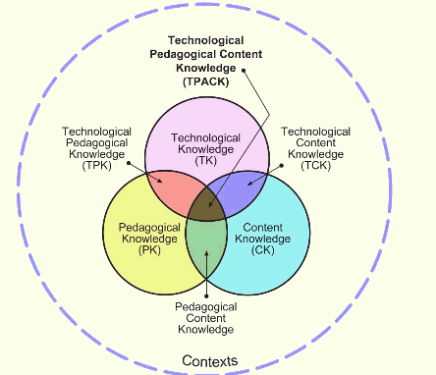
eLearning TPACK model
Teaching Teachers for the Future (TTF) - Australasian Journal of Educational Technology 2012 co author Professor Geoff Romeo, Ed Faculty ACU
TPACK (Technological Pedagogical Content Knowledge) is a conceptual framework for teacher education
TPACK is the basis of good teaching with technology and requires an understanding of the representation of concepts using technologies; pedagogical techniques that use technologies in constructive ways to teach content; knowledge of what makes concepts difficult or easy to learn and how technology can help redress some of the problems that students face http://punya.educ.msu.edu/publications/journal_articles/mishra-koehler-tcr2006.pdf

Slide 11
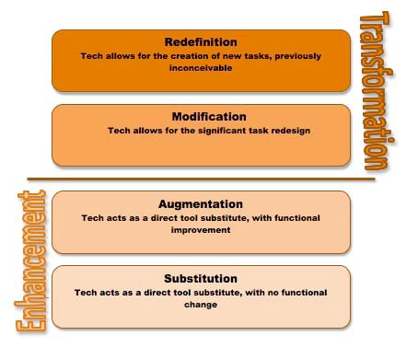
eLearning SAMR model
Developed by Dr.Ruben Puentedura called SAMR that has been widely used in developing ideas about the impact of technological developments and how teachers might extend its possibilities.

Slide 12
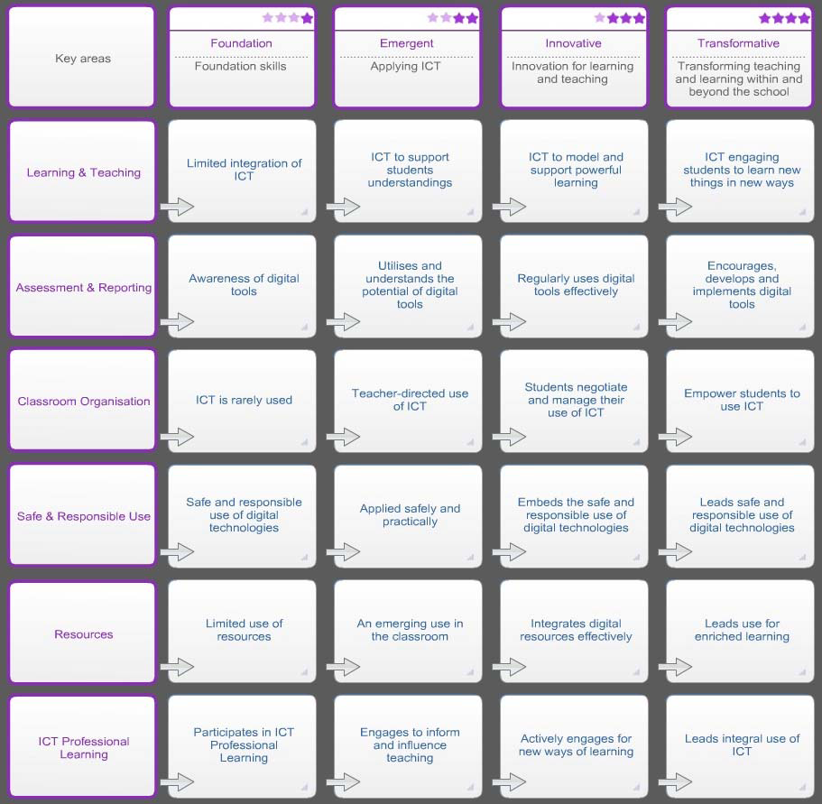
eLearning epotential model ( Victorian DEECD)

Slide 13
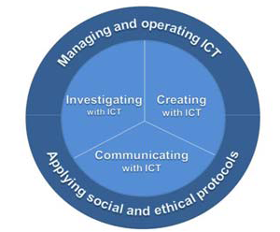
eLearning epotential model ( Victorian DEECD)
These competencies directly relate to the Australian Curriculum and Assessment Authority (ACARA) Continuum designed to meet the expected knowledge, skills and dispositions of students in P – 10

Slide 14
Research on eLearning ? (video )
It’s not what the technology does that makes it effective, but what the student does - Evidence Based Teaching - A practical approach Geoff Petty (2006)
Advance organisers: (Average effect size from .48 to .78 depending on complexity). Giving students summaries in advanced of what they are about to learn
Relevant recall questions (Average effect size 0.93) questions designed to bring useful, and essential prior learning into the learner’s short term memory, and to check it, before building the new learning upon these foundations.
‘Same and different’: (Average effect size 1.32) identify similarities and differences between two or more topics or concepts, often one they are familiar with, and one they are presently studying

Slide 15
Research on eLearning ? ( contd )
Graphic Organisers: (Average effect size 1.24) student creates their own diagrammatic representation of what they are learning, for example in a mind-map
Note Making. (Average effect size .99) Students create personal notes on the information being presented in their own words. Students need to get feedback on the quality of their notes.
Decisions-Decisions: (Average effect size .89) Students physically manipulate cards or objects or symbols which represent concepts or ideas they are learning about
Teach skill as well as content (Average effect size 0.77) If the teacher makes time to teach students important study skills and thinking skills and integrates this into their teaching, then students both learn these important skills and their achievement is improved with an average effect size of 0.77.

Slide 16
Research on eLearning ? ( contd )
Feedback (formative assessment) (Average effect size up to 1.13) Giving students information about what they have done well and what they need to improve either directly, or indirectly e.g. by requiring them to mark their own and each other’s work against model answers or mark schemes and other ‘formative teaching methods’. Praise alone e.g. ‘well done that is very good’ has very little effect, about 0.08. Peer and self assessment have very high effect sizes,
Generating and testing hypotheses (Average effect size 0.79)
Cooperative learning (Average effect size.78) students teach each other and check each other’s learning.
Homework and Practice (Average effect size .83 if there is feedback from the teacher on the quality of the work, more generally about 0.6)
http://www.geoffpetty.com/downloads/WORD/EvidenceBasedICT.doc

Slide 17
Aligning Curriculum, Instruction and Assessment
Planning | Instructional Strategies | eLearning Strategy ?
What will students learn ? | Setting objectives | How ?
Which strategies will provide evidence of student learning ? | Providing feedback Providing recognition Providing adaptive assessment for and as learning | How ?
Which strategies will help students acquire and integrate learning ? | Addressing multiple learning styles Learning non-linearly Cooperative learning Reinforcing effort | How ?
Which strategies will help students practice, review and apply learning? | Providing community learning Access to multi channels Homework and practice Reward for achievement Challenging and extending | How ?
Using Technology With Classroom Instruction That Works By Howard Pitler

Slide 18
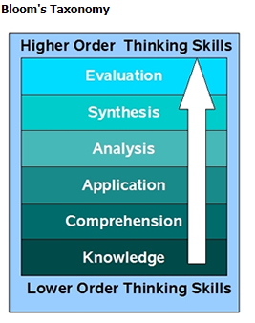
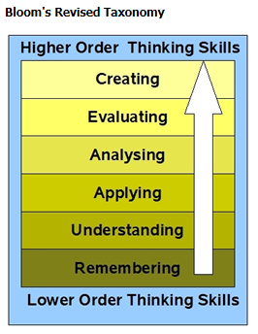
eLearning –learning skills
Benjamin Bloom 1950s
Lorin Anderson 2001

Slide 19
http://edorigami.wikispaces.com/file/view/bloom's+Digital+taxonomy+v3.01.pdf

Slide 20
Higher order thinking or wizard driven end product ?
Blogging – http://blogspot.com
vs
Filter writing through a Word processor to
improve spelling, grammar, expression, vocabulary
Animating – http://www.dvolver.com/moviemaker/make.html vs
Using Flash and ActionScript 3.0
Wiki-ing – http://wikispaces.com
vs
Filter writing through a Word processor to
improve spelling, grammar, expression, vocabulary
Programming - http://www.sploder.com vs
Programming in XNA Visual C# language

Slide 21
eLearning in practice – what does it look like ?
Learning environment - Cisco Enterprises
Simulation software – packet tracer
Learning environment – moodle
Specific applications and tools – Fuse ?
SCORM compliance – applications that hook into Learning Management Systems (LMS)
Games for Learning ? Xbox programming task sample
Others ?

Slide 22
eLearning – what did students learn ?
Students learned to:
identify network components,
select and connect network components to build a network
simulate a live network with the software packettracer
test its functionality and performance,
identify areas of improvement
use online quizzes for formative assessment

Slide 23
eLearning – at what standard did we learn ?
Students performed at the following standards, criteria and learning outcomes:
at Yr 10, VELS level 6.25, ICT for creating:
creation of information products by using functions from different software tools and equipment; packettracer to create and simulate a network, test rules of data movement, check hypotheses and design objectives.
At AusVELS standard … from 2013
At AQTF standard Certificate III
At VCE standard Unit 1, IT in Action Outcome 22, KK 4 and 5

Slide 24
eLearning – where is the validation and evidence ?
Students build a product or create a solution using skills and knowledge
They are tested against a set of criteria aligned at a level or standard
They are peer reviewed and reshape their work in a social constructionist framework
They are teacher reviewed with feedback to improve their work
They apply the new found knowledge to modify, improve or enhance the solution or product
Work is communicated and presented for summative assessment

Slide 25
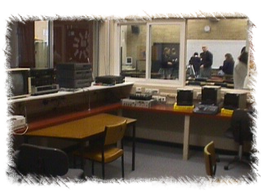
Study titled “e-learning champions on embedding e-learning”
eLearning – how do we sustain embedded eLearning ??
elearning champions are :
“people who have demonstrated leadership and as a consequence have significantly influenced or developed the e-learning capacity of their business unit, organisation or have had an influence beyond their immediate organisation.”
(Study brief definition refined by study team)
Embedding is:
“The final stage of an innovation process that starts with an initial decision to engage (adoption), moves to spreading the word (diffusion), consolidates in utilisation (implementation), and culminates in embedding.”
(Jasinksi, 2006, p. 1)
http://www.flexiblelearning.net.au/content/benchmarking-and-research-publications#champions

Slide 26
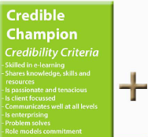
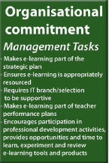
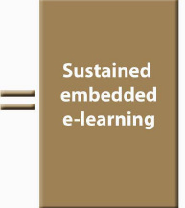
What is sustained, embedded eLearning?
http://www.flexiblelearning.net.au/content/benchmarking-and-research-publications#champions

Slide 27
epotential
epotential continuum. An interstate initiative reworked as Victorian around 2006
Note SA vs Victorian performance level comparison:
Most jurisdictions have similar continuums.
Please log on to the epotential survey to explore the types of questions asked epotential.education.vic.gov.au
Uncertain and or hesitant | Willing but Dependent | Confident and proficient | Leading and enabling others
Foundation | Emerging | Innovative | Transformative

Slide 28
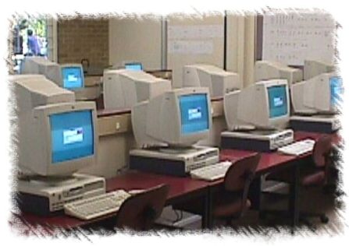
Necessary and Sufficient
For eLearning to take place | Necessary ? | Sufficient ?
students have to be engaged with technology
students have to create with technology
students learn with technology meeting the relevant VELS or AusVELS standards
the use of technology needs to be aligned with the learning objective at the relevant standard
students need be confident with technology
“The use of technology does not guarantee learning”
http://www.geoffpetty.com/evidence_based.htm

Slide 29
Now what ?
Let us list a few goals for ourselves and our Domain
Let us communicate clearly what we want students to learn
Let us be discriminating with our choice of learning activities with eLearning
Search online for good and bad eLearning for reflection
Let us promote adaptable eLearning which in turn will promote differentiation
Let us give our students multiple pathways to enhance engagement that leads to genuine higher order thinking and learning
Let us measure the impact of our strategy to validate our efforts

Slide 30
Conclusion
eLearning is not the device or app; it is the learning at the level or standard intended
eLearning is dynamic and rapidly changing
eLearning needs to be measurable
Technology is necessary, but not sufficient without the alignment with the learning strategy
eLearning is learning - with technology
see http://delicious.com/kkrozian for references

